Slide 1
Assignment #4 – Chi-Squared Analysis
Submitted By : Jay Panchal
Student ID: 100960958

Slide 2

Description of Analysis
Chi-squared test is a statistical method used to assess the independence between two categorical variables. In this case, we will analyze a contingency table where rows represent passenger capacity (e.g., 2,4,5,6,7,8) and columns represent airbag types (e.g., driver only, driver & passengers, none).The analysis will compare the observed frequencies (actual number of cars in each category) with the expected frequencies (number of cars expected if passenger capacity and airbag type are independent).

Slide 3
Hypothesis Testing Steps for Chi-Square Analysis
1. State the Hypotheses: Null Hypothesis (𝐻0): The passenger capacity and the type of airbag in cars are independent. There is no significant correlation between them. Alternative Hypothesis (𝐻1): The passenger capacity and the type of airbag in cars are not independent. There is a significant correlation between them.
2. Significance Level (𝛼):
The significance level, denoted as 𝛼α, is a threshold set by the researcher to determine whether a result is statistically significant. It represents the probability of rejecting the null hypothesis when it is actually true (Type I error). Common choices for 𝛼 are 0.05 (5%), 0.01 (1%), and 0.10 (10%). For our analysis: We will use a significance level of 𝛼=0.05.
3. Calculate the Chi-squared Statistic:
The Chi-squared statistic is computed by summing the squared differences between observed and expected frequencies, divided by the expected frequencies.
The formula is:
χ 2 =∑ (O − E​ ) 2 / E ​
Where,
O = Observed Frequency
E = Expected Frequency
4. Determine the Degrees of Freedom :
Formula: The degrees of freedom for the test is calculated using the formula (number of rows−1)×(number of columns−1)(number of rows−1)×(number of columns−1). This helps us to identify the appropriate distribution to compare our Chi-squared statistic against.
Compare the Chi-squared Statistic to the Critical Value:
Critical Value: Compare the Chi-squared statistic to the critical value from the Chi-squared distribution table at a chosen significance level (e.g., 0.05). If the Chi-squared statistic exceeds the critical value, we reject the null hypothesis.
p-value: Alternatively, compare the p-value obtained from the Chi-squared test to the significance level. If the p-value is less than 0.05, we reject the null hypothesis, indicating a significant correlation between Passengers and AirBags. 5. Conclusion: Based on the Chi-squared test results, we reject the null hypothesis that the passenger capacity and the type of airbag in cars are independent. This indicates that there is a significant correlation between passenger capacity and the type of airbag.

Slide 4
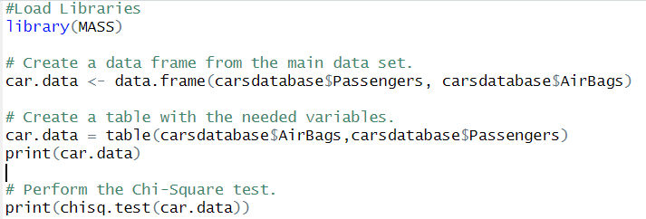
Conducting the Analysis

Slide 5
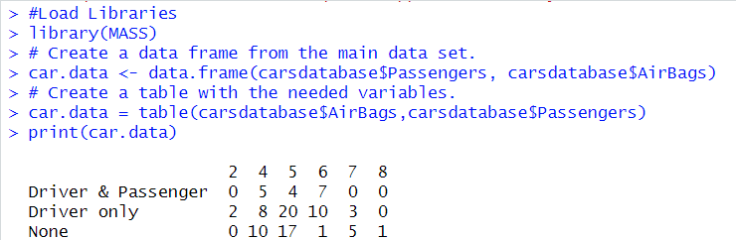
Conducting the Analysis

Slide 6
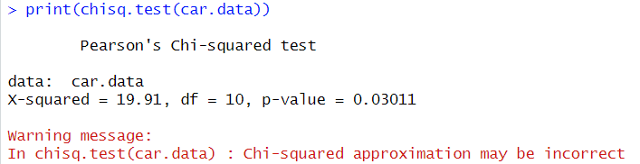
Conducting the Analysis
Chi-squared Analysis Results: Chi-squared Statistic (𝜒2): 19.91 Degrees of Freedom (df): 10 p-value: 0.03011 Interpretation: Since the p-value (0.03011) is less than the significance level of 0.05, we reject the null hypothesis. This indicates a statistically significant correlation between passenger capacity and the type of airbag installed in cars. Insights and Findings: Passenger Capacity Influences Airbag Type: The significant correlation suggests that the number of passengers a car can carry affects the choice of airbag type. This could be due to the need for different safety features in vehicles with different passenger capacities. For instance, larger vehicles designed to carry more passengers might require airbags that provide broader coverage or different deployment mechanisms compared to smaller vehicles.
Interpretation of the Warning Message: This warning message indicates that the Chi-squared test's approximation might be unreliable. This situation often arises due to small expected frequencies in the contingency table. The Chi-squared test relies on an approximation that assumes a sufficiently large sample size; when expected frequencies are too low (typically less than 5), this approximation can become inaccurate.

Slide 7

Combination
Transmission Type and Fuel Type: Reason: Understanding the relationship between transmission type (automatic, manual) and fuel type (petrol, diesel, electric) can provide insights into market preferences and help manufacturers target specific segments more effectively.
Potential Impact: This analysis can help in strategic planning for new vehicle designs and marketing campaigns by highlighting trends and consumer preferences.
Horsepower and Car Weight:
Reason: Investigating the relationship between horsepower and car weight can reveal performance trends and the trade-offs between power and fuel efficiency.
Potential Impact: This information can be used by engineers to design more efficient engines and by marketers to promote cars based on performance metrics that appeal to different customer segments.

Slide 8
Thank you!

